Slide 1

Communication Skill

Slide 2




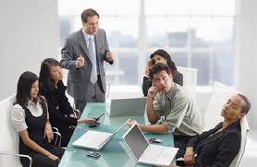
What can you find differences of pictures?
Group 1
Group 2
Good communication
Bad communication
Comfortable
Attractive to listeners
Understand
Not attract listeners
Inefficient
Uncomfortable

Slide 3
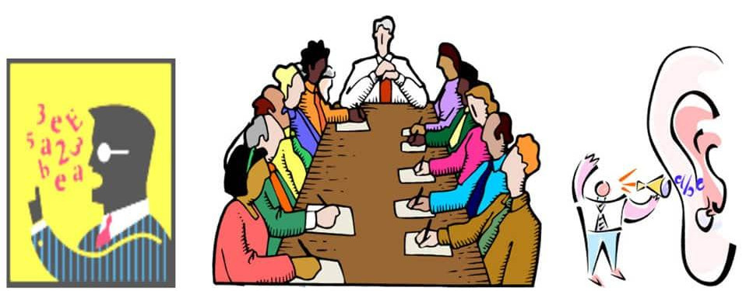

Do you think communiation skill is important?
In the work
Communicate ideas and information effictively.
Build good relationships,resolve conflicts.
Promote understanding and cooperation.
Creat a positie and frendly environment.
2. In the life
Personal communication
Family communication
Social communication
Community communication

Slide 4

How to improve communication skills?

